Slide 1
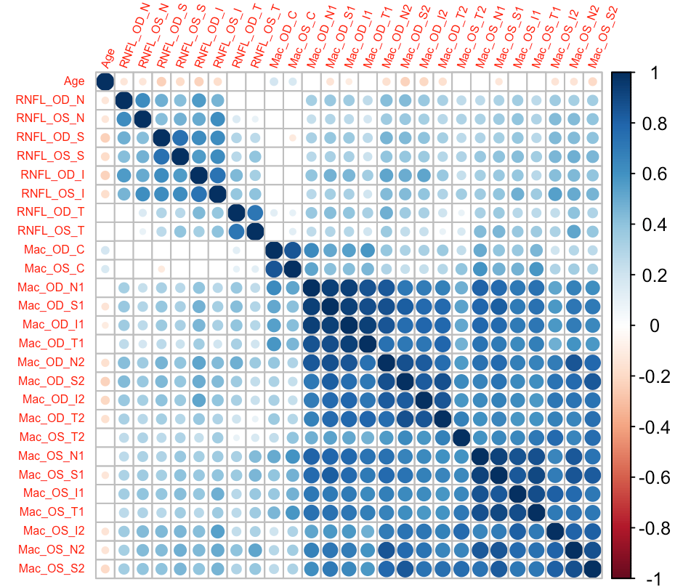
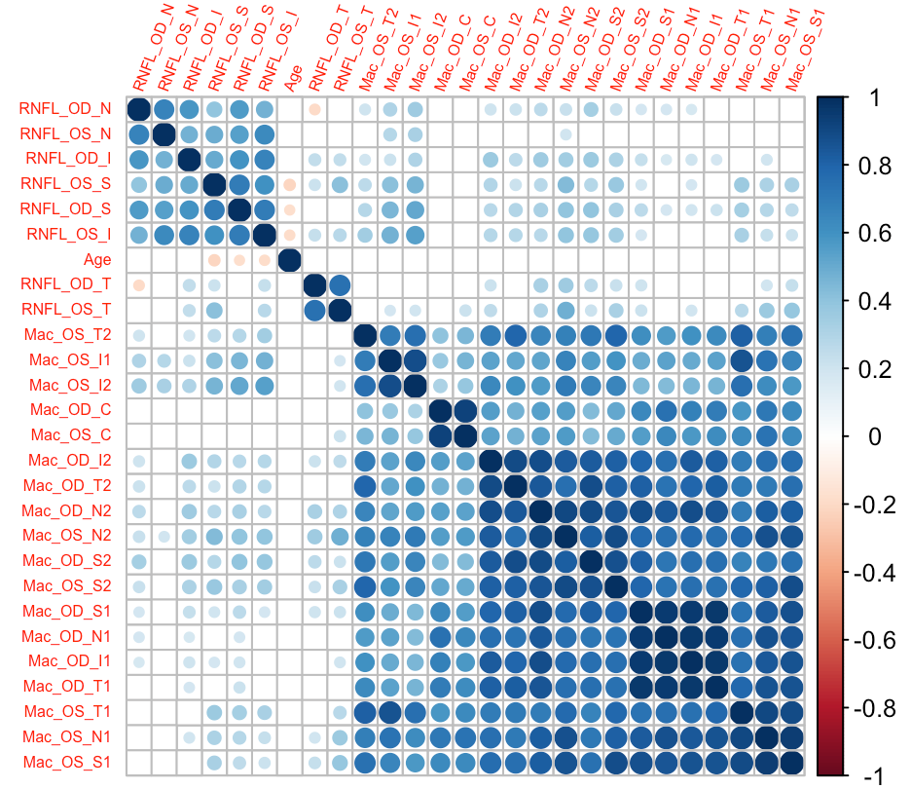
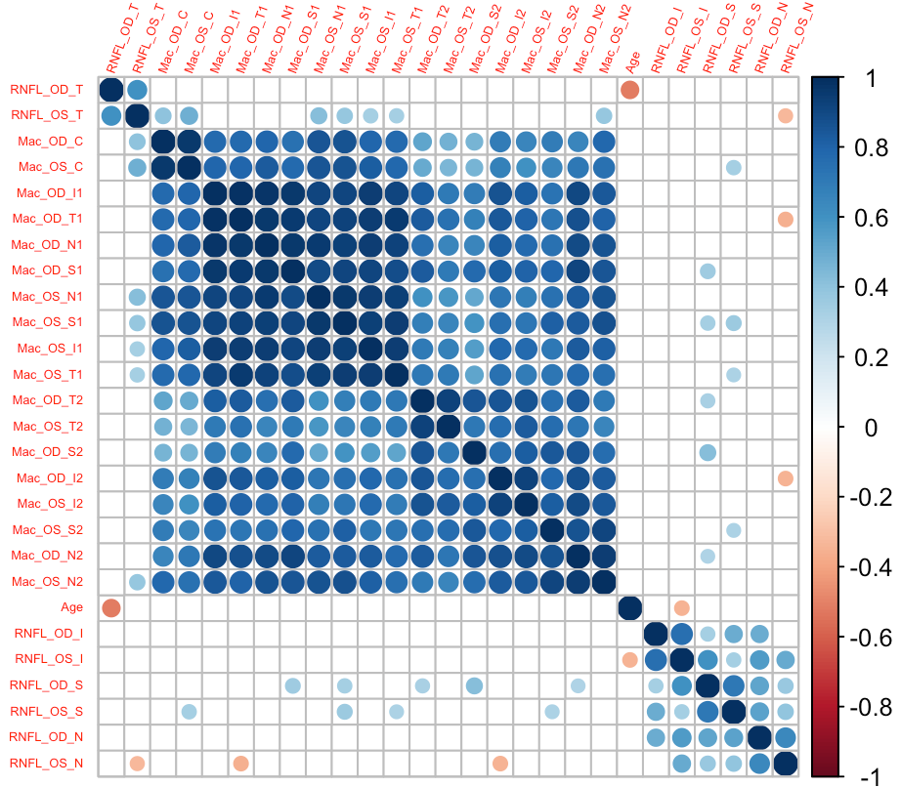
Correlation plots for all OCT outcomes (RNFL and ILM/RPE) and Age
Full data (n=640)
Non-MS cohort (n= 130)
Healthy donors (n=41)

